Slide 1
LUNACHELLA APP
Concert-full stack development

Slide 2
Background
About :
Luna means “moon” in Italian and Neapolitan
Chella mean music, vibes, and festivals .
Inspiration : Coachella and Bandsintown

Slide 3
Technical Overview
Technologies used:
React
Firebase(Authentication)
Neon Console(db)

Slide 4
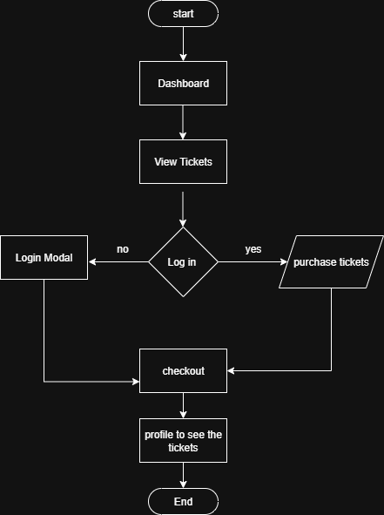
Flow Chart

